Slide 1

Design and Analysis of Algorithm
Dots and Box Game
Presented by: TY03

Slide 2
Team Members:-
Roll no NAME GR. NO.
3 Aarya Tiwari 12010588
5 Harshal Abak 12011089
9 Abu Ansari 12010599
26 Kaivalya Aole 12011351
Guided By:- Prof. Pushkar Sir

Slide 3
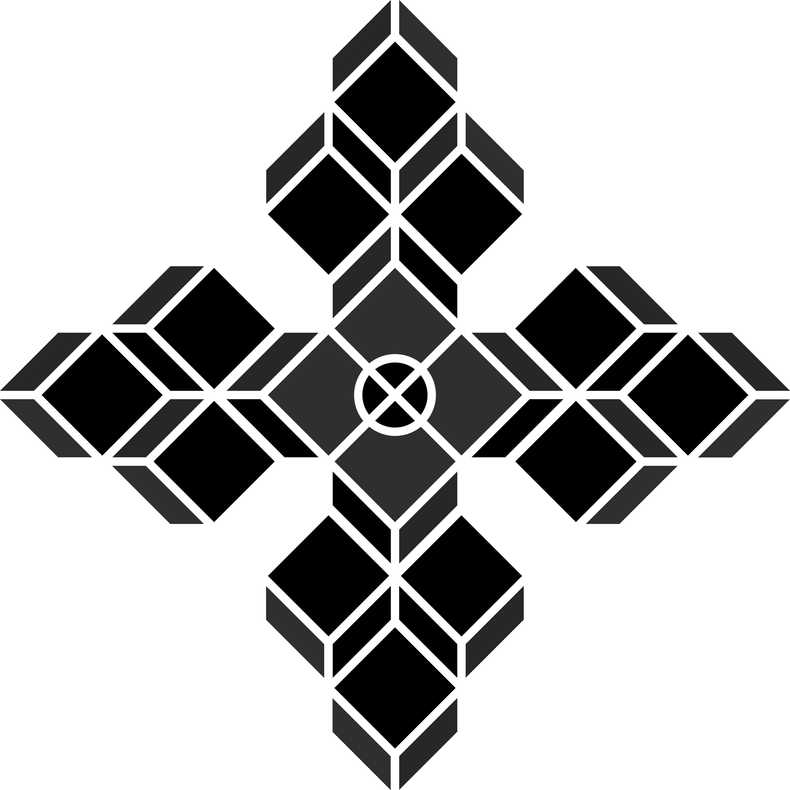
Content of the Presentation
Introduction
Greedy Approach
Greedy Example
Dynamic Programming
D.P. Example
Differences
Conclusion

Slide 4
Introduction
Dots and Boxes is a pencil-and-paper game for two players. For CP we tried to make this a AI based game, where the player competes against computer.
Here as a input we take the number of rows and columns from the user and also ask for the level of difficulty they would like to play on. The game start with a grid of justified dimension with some random score assigned to each block.
The winner is decided on the value of total score. Here, is the total score is in negative the AI/ Computer wins else the player wins. The algorithm that we used over here is minimax Algorithm and Alpha- beta pruning.

Slide 5
About the Algos..
Minimax is a kind of backtracking algorithm that is used in decision making and game theory to find the optimal move for a player, assuming that your opponent also plays optimally.
In Minimax the two players are called maximizer and minimizer. The maximizer tries to get the highest score possible while the minimizer tries to do the opposite and get the lowest score possible.
Every board state has a value associated with it. In a given state if the maximizer has upper hand then, the score of the board will tend to be some positive value. If the minimizer has the upper hand in that board state then it will tend to be some negative value.

Slide 6
About the Algos..
Alpha-Beta pruning is actually a algorithm that is an optimization technique for the minimax algorithm.
It tries to reduce the computation time by a huge factor. This allows us to search much faster and even go into deeper levels in the game tree.
As we know in the minimax search algorithm the number of game states it has to examine are exponential in depth of the tree. Since we cannot eliminate the exponent, but we can cut it to half.
Hence there is a technique by which without checking each node of the game tree we can compute the correct minimax decision, and this technique is called pruning.
This involves two threshold parameter Alpha and beta for future expansion, so it is called alpha-beta pruning. It is also called as Alpha-Beta Algorithm.

Slide 7
Disadvantage of Alpha – Beta Pruning
The main disadvantage of Alpha Beta pruning is that alpha beta pruning requires setting a depth limit, as in most cases, it is not feasible to search the entire game tree.
Also it does not solve all the problems associated with the original minimax algorithm.

Slide 8
Thank You
Any Questions!

